Slide 1


Flight Price Prediction Project
Submitted by:
Junaid Shaikh

Slide 2
Introduction
Anyone who has booked a flight ticket knows how unexpectedly the prices vary. The cheapest available ticket on a given flight gets more and less expensive over time
In first phase we have to collect data of flights ticket from online websites. Here data is collected from “www.yatra.com” website using Selenium technique.
Our goal is to build a regression model to predict price of flight ticket.
We have also performed the EDA to gain insights of the data.

Slide 3
Data Set Description
Features:
Name: name of Airline
Date: date of journey
Departure: time of departure
Arrival: time of arrival
Source: the source from which service begins
Destination: the destination where service ends
Stops: total number of stops between source and destination
Duration: total duration of flight
Price: Price of flight ticket
The dataset has no null values.

Slide 4
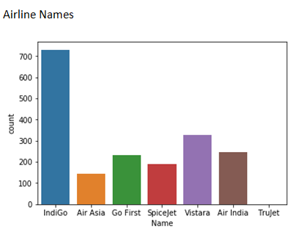
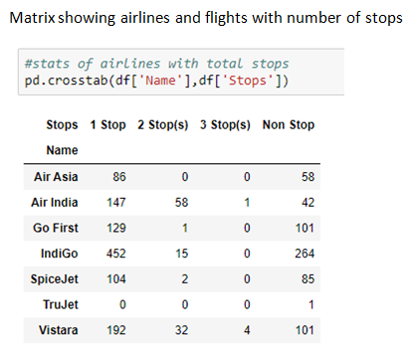
Data Visualizations

Slide 5
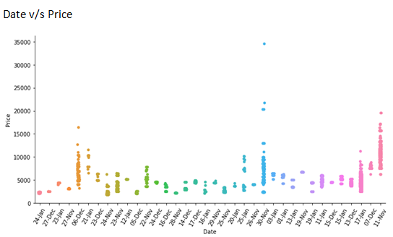
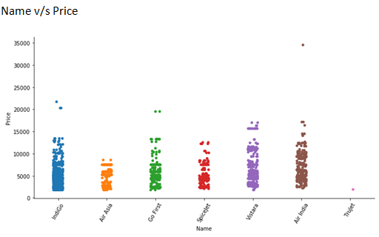

Slide 6
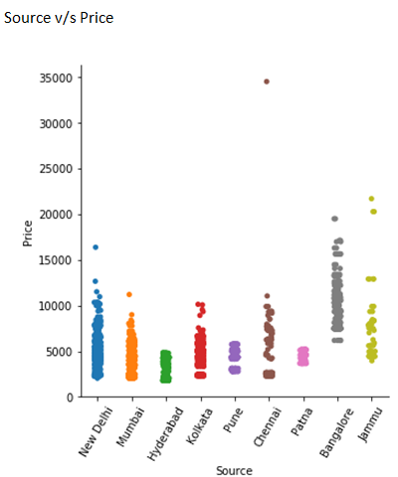
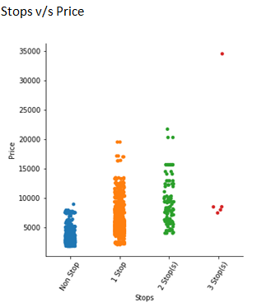

Slide 7
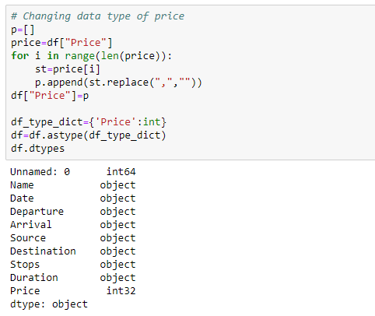
Data Pre-Processing
First we will clean price column by removing ‘,’ and changing it’s data type to ‘int’

Slide 8
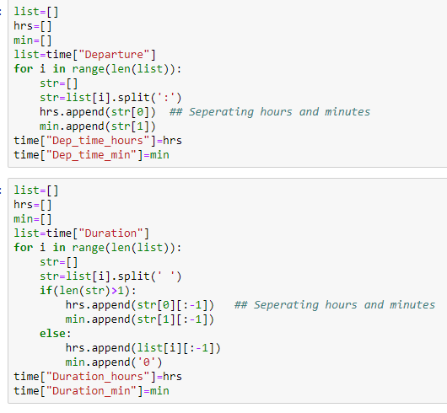
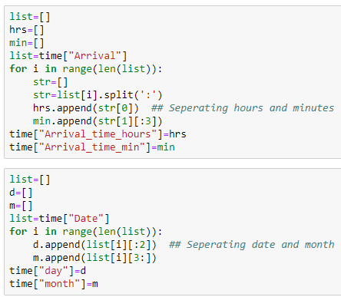
Next we have removed unnecessary columns and cleaned data in “Arrival”, “Departure”, “Duration” and “Date” and derived new features from each given feature. I have first formed a new data frame and then done all the processing.

Slide 9
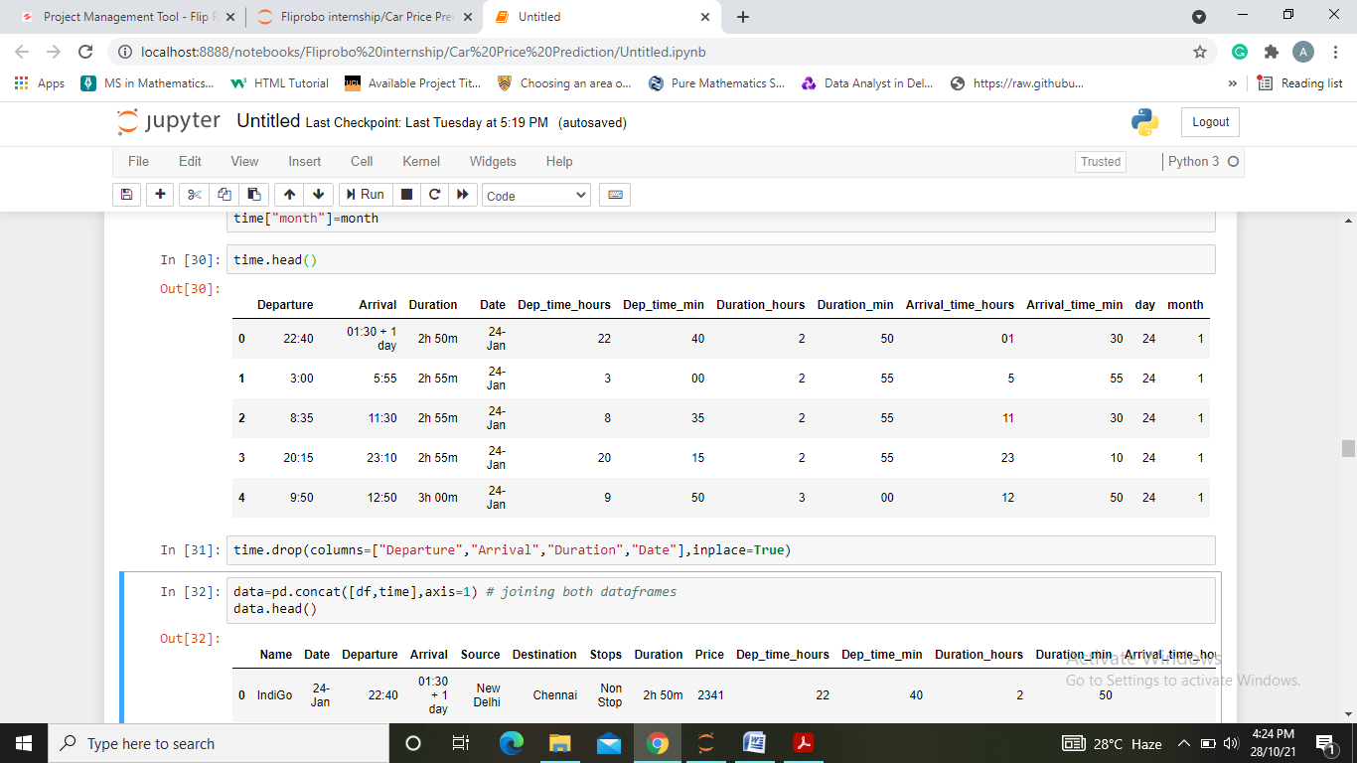
After executing the above lines of code we will get 8 new columns Dep_time_hours, Dep_time_min, Duration_hours, Duration_min, Arrival_time_hours, Arrival_time_min, day and month. Each feature now has integer data type. Since all the usefull information is now extracted we can drop previous columns.

Slide 10
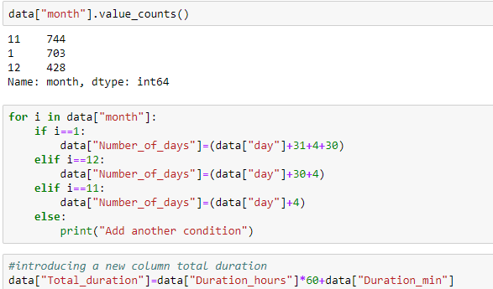
Next we have introduced two more columns as “Number_of_days” giving the ticket price number of days before the flight service and “Total_duration” giving total time of service.

Slide 11
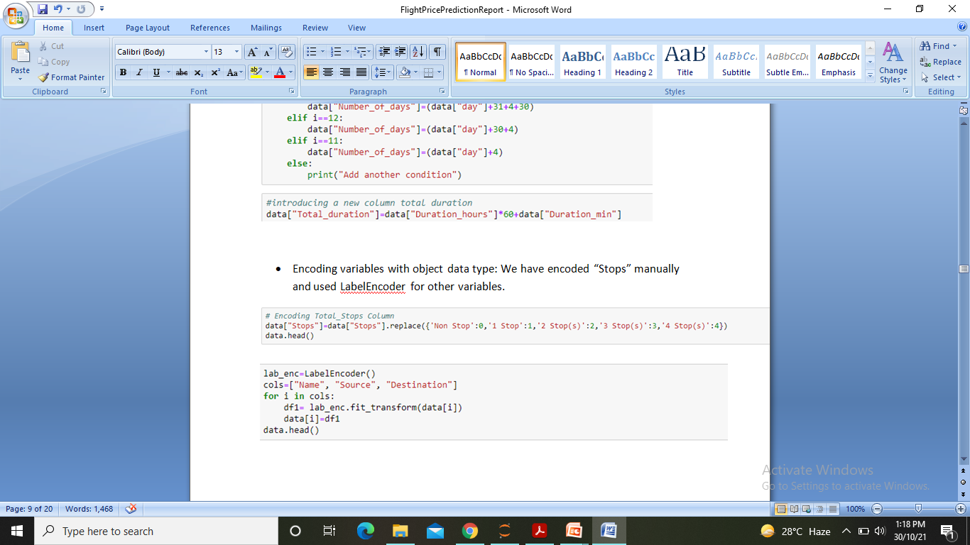
Encoding variables with object data type: We have encoded “Stops” manually and used LabelEncoder for other variables.
We also observed outliers and skewness in data for which we used z-score method and log transformation to deal with it. In this process we faces a data loss of 2.5%.

Slide 12
PREPARING DATA FOR MODEL
Making our Data ready for model Building phase we will first separate target variable from other features. Then use StandardScaler to scale data and use train_test_split to split data into train and test to make it ready for model.
For train_test_split we found the best random state by running a loop on linear regression and checking for best accuracy.

Slide 13
MODEL BUILDING AND EVALUATION
Algorithms used are:
Linear Regression
Decision Tree Regressor
KNN Regressor
Random Forest Regressor
Gradient Boosting Regressor

Slide 14
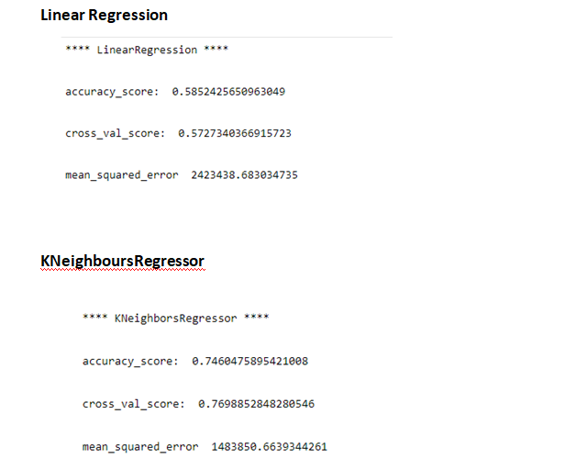

Slide 15
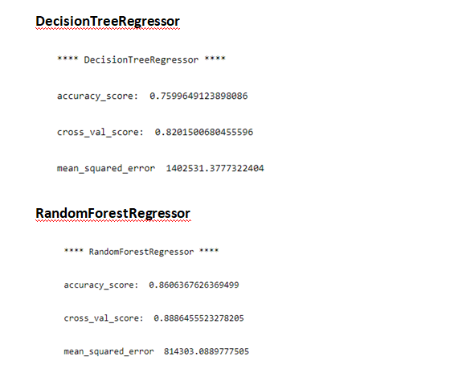

Slide 16
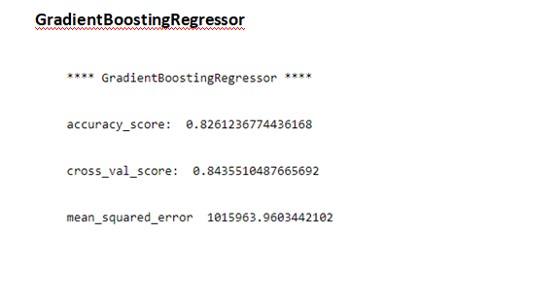

Slide 17
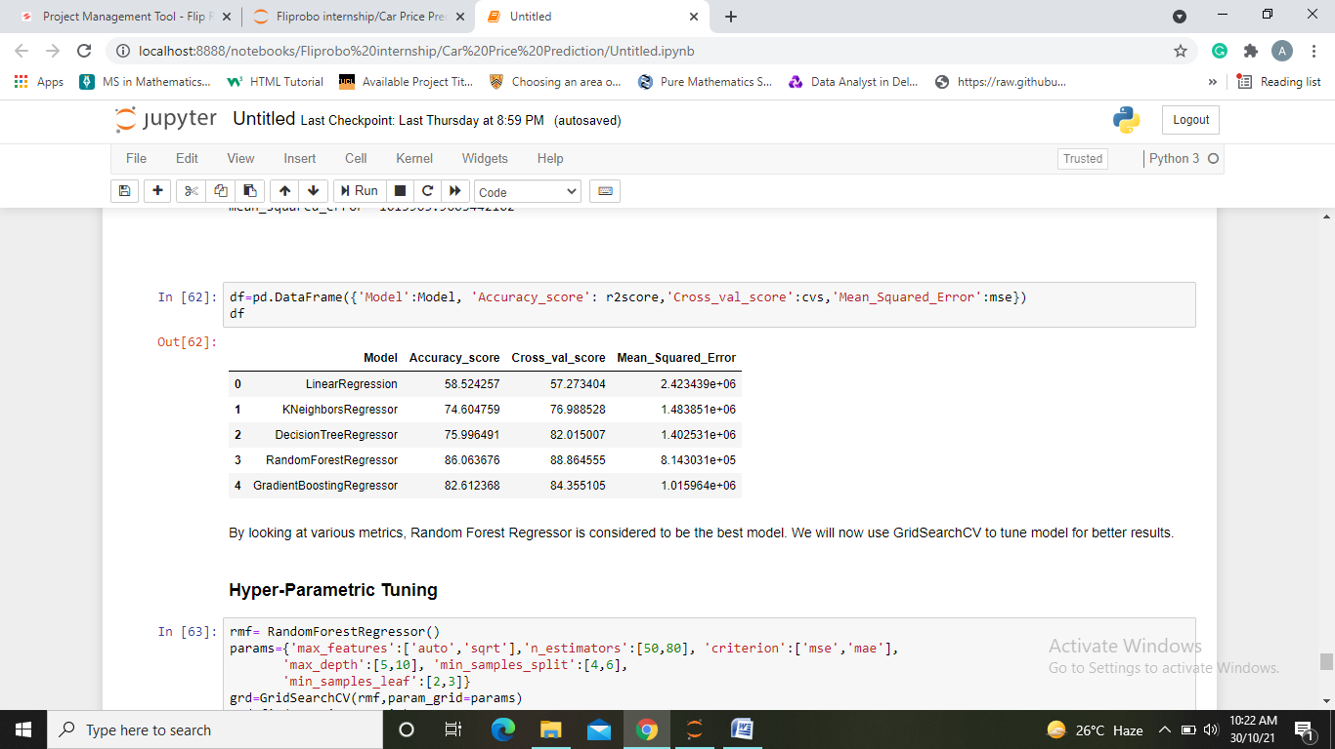
Choosing Best Model
After running the loop we get a dataframe showing each model and scores obtained from it.
Looking the various metrics we conclude “Random Forest Model” as our best model and hence we will now tune our model.

Slide 18
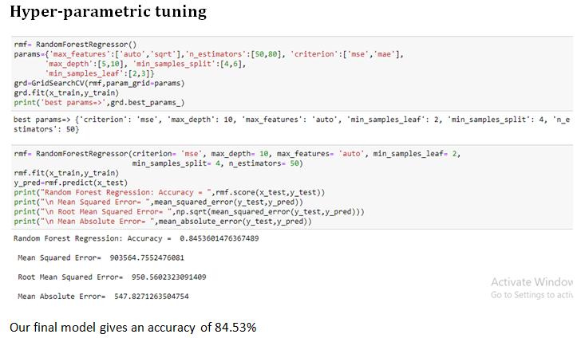

Slide 19
Conclusion
First, we collected data on flight ticket prices from “yatra.com”, it was done by using Web scraping. The framework used for web scraping was Selenium.
Then the scrapped data was saved in a csv file to use it for modeling purpose.
From the extensive EDA performed in this project we observed:
Flights from Bangalore and Jammu have higher prices.
Flights with longer route i.e. high number of stops have high prices.
Also, prices of flight in next month are high as compared to those in coming months.
From the given data we can also conclude that AirIndia and vistara flights are expensive as compared to other flights.
The model build after hyper-parametric tuning gives an accuracy for 84.53%

Slide 20
After the completion of this project, we got an insight of how to collect data, pre-processing the data, analyzing the data and building a model. It helped me to gain conclusions from graphs. Also it helped me in exploring multiple algorithms and metrics to get the best output.
Since the data keeps changing we cannot fully rely on this project in the distant future we need to update it with updation in data
. Also the scrapping of data took a lot of time as there was no such detail mentioned on fetching data. Random sources and destinations are used to pick up data.
This project is done with limited resources and can be made more efficient in future..

Slide 21
Thank you

